Slide 1
Notes:
NAIFA is the National Association of Insurance and Financial Advisors. We are what the bar association is to attorneys. My name is _________. Like others in the audience today, I am a volunteer with NAIFA.

Slide 2
NAIFA’s
Membership
Promise
Notes:
NAIFA makes a Membership Promise to
Advocate for you and your clients
Educate you so you can better serve your clients
Differentiate you from other advisors and agents
Along with NAIFA’s promise, I’m making my personal promise to you that NAIFA will always advocate for you, educate you and differentiate you.

Slide 3
Advocate.
The protective advisor.
Notes:
Advocate…NAIFA members are the protecTIVE advisor…NOT the protectED advisor…the protectIVE advisor.

Slide 4
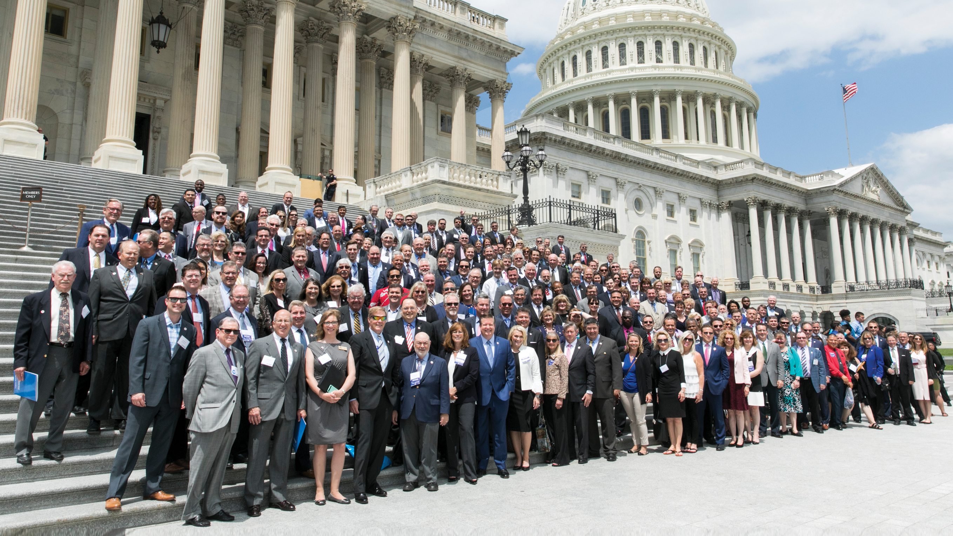
A NAIFA Member In Every Congressional District
The Power of You.
The Power of Us.
Notes:
NAIFA protects our clients in Washington DC…all 50 state capitals…and NAIFA has a member in every Congressional District.
No other association in the insurance and financial services industry and operating in our space make this claim.
NAIFA combines and leverages the power of our individual members into the power of us to protect our clients no matter where they may reside.
Last year, NAIFA sued the federal government over the Dept. of Labor Fiduciary Rule and we won.
Recently, 600 NAIFA members went to Washington to lobby for passage of the Secure Act, and the very next week the bill passed the House.
[Add an example from your state of a legislative or regulatory victory here]

Slide 5
Notes:
A study by the Washington, DC based National Journal shows NAIFA as the most influential advocacy group in the industry. We, NAIFA, the most influential group in the industry – it doesn’t get any better than this.
All of those in the audience who are NAIFA members, please raise your hand
[Do this to identify those you are trying to close to get a sense of who and how many you are speaking to.]
For those of you who didn’t raised your hand, you are getting this for free. The NAIFA member sitting next to you has been paying for this for you. Do I believe everyone here should be a member to support NAIFA’s advocacy efforts…yes…but I will respect your decision not to be.
Let me give you some selfish reasons why you should be a NAIFA member.

Slide 6
Educate.
The thinking advisor.
Notes:
NAIFA members are the Thinking Advisor.
NAIFA Educates you in a way no other association does. We educate those who are new to the business and those who consider themselves elite advisors or Top of the Table MRDT advisors.

Slide 7
Watch Virtually or at a Watch Party
On Demand Archive
State Based CE
Notes:
NAIFA has a program called NAIFA Live where you can hear from top speakers around the country.
You can dial in to the live event from your desktop or mobile phone or you can participate in a Watch Party in your area where you can watch the presentation and participate in group discussions about the topic.
If you can’t participate in real-time, the programs are all recorded so you can access them on-demand at your convenience.
CEs may also be available in some states.
[If your state offers CEs, make sure you point this out.]

Slide 8
The NAIFA LECP Center
Rethink Long-Term Care
Notes:
NAIFA’s Limited and Extended Care Planning Center is changing the way consumers think about Long Term Care.
NAIFA came up with this concept a few years ago and reached out to companies in the long term care space with the idea. Many of them had wanted to build out a site like this but either didn’t have the resources or the expertise to do it. NAIFA raised nearly a half million dollars from 15 founding sponsors to create this site.
As a member you have access to this site to help you help your clients plan for their future.

Slide 9
Business Performance Center Formally Advanced Practice Center
Notes:
Level Up.
Brand new to NAIFA, the Business Performance Center formally known as the Level Up Roadshow is designed for members working in the Advanced Markets or those wanting to expand their practice into these markets.
The first workshop was in Dallas on August 22 and another will be in Charlotte in October. You can attend in person or virtually or join a watch party.

Slide 10
Letterpress next level trust fund, before they sold out +1 meh gluten-free locavore tacos PBR&B tofu.
Target Infographic Slide
Analysis 06
Synth chartreuse XOXO, tacos brooklyn VHS plaid.
Notes:
And there’s more… The Talent Development Center focuses on providing personal development programs to serve every stage of a financial service professional’s career.
LACP. Life and Annuities Certified Professional. Although FINRA recognizes hundreds of designations only eleven are certified by an outside agency. Many companies have recognized the importance of this designation and allow their producers to use it.
Professional Pathway. Truly unique to NAIFA, this tool lets members map out an education program whether they are brand new to the business, mid-career or a senior advisor. No other association in our space is set up to serve members at every stage of their career
---------------
[Other programs you can highlight if time allows]
LUTCF. Life Underwriter Training Council Fellow is a designation members can earn after completing in-depth courses on life underwriting.
Our Learning Center is where you can drop in virtually to access programs and materials specific to your practice area.
NAIFA’s Performance plus Purpose Conference features top speakers to inspire and educate members with sales tips and market insights to take their practice to the next level.

Slide 11
Differentiate.
The trusted advisor.
Notes:
Differentiate.
How are NAIFA members different?
There are various studies that have been done…not by NAIFA, but by others…that show that NAIFA members earn $10,000 to $43,000 more than non members. Why is this?
NAIFA members are the trusted advisor.

Slide 12
The NAIFA
Code of Ethics
Notes:
NAIFA members take a pledge always to put their clients’ best interests ahead of their own.
Our members take this pledge very seriously.
Few associations operate with a code of ethics that includes a best interest statement.
Who here would not take that pledge?
Who here would not stand up and say I always put my clients’ best interests ahead of my own?

Slide 13
Promotes Consumer Awareness
Find an Advisor Search
Main Street USA messaging
Notes:
AdvisorsYouCanTrust.org is NAIFA’s site to promote consumer awareness and how NAIFA members serve Main Street USA.
Consumers can go find an advisor or agent who is a NAIFA member that subscribes to our code of ethics.
Members can write consumer-focused articles for the site and be profiled on the site.
Soon members will be able to have their photo and additional information about their practice included with their directory listing on the site.

Slide 14
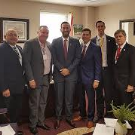
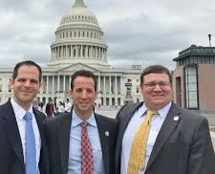
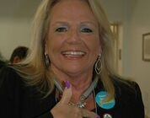
Connected Community for Life
Notes:
NAIFA members are connected to a community of like-minded individuals. NAIFA members openly share their ideas and best practices with one another. NAIFA members service their community via NAIFA sponsored events.
[Add a personal story about your connection to the community. Share a story about how a member gave you an idea that helped you close a case or an experience you’ve had through a community service project working alongside your fellow members]

Slide 15
POWER OF THE PIN Delivering on NAIFA’s Membership Promise
Notes:
[Always have your NAIFA pin on! Point to it!]
See this pin?
It is a symbol that
I advocate for my clients.
I am committed to educating myself to better serve my clients
I always put my clients’ interest before my own
On a personal note, I wear this on every client meeting because my clients often ask me about it….when they do, I say:
“I am a member of the National Association of Insurance & Financial Advisors, my professional association. As a member, I take a pledge to always act in my clients’ best interest. It’s like the AMA for doctors…you wouldn’t go to a doctor that wasn’t a member of the AMA, would you?” I also say, “Over the next few weeks, you will decide whether you want to work with me or not as your financial advisor…if you decide not to work with me, I encourage you to go to advisorsyoucantrust.org and find another NAIFA member who has made the same pledge as I have to always put your interests above their own”.

Slide 16
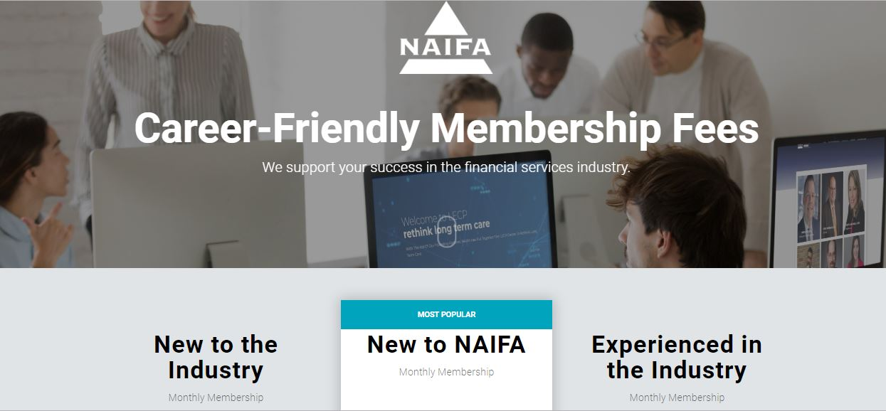
Notes:
At NAIFA, we have a career friendly fee structure designed to be affordable regardless of your time in the industry.

Slide 17
Graduated Fees Structure
Year 1 in Industry: $10/month
Year 2 in Industry: $20/month
Year 3 in Industry: $30/month
Year 4 in Industry: $40/month
Year 5+: $56/month
www.naifa.org/join
NEW TO NAIFA
3+ Years in Industry & new to NAIFA: $30/month for Year 1 and then graduate up
Notes:
This is the close.]
Take out your phones….
[Lightheartedly]
I know you have them with you because you’ve been looking at them while I’ve been talking. Go to NAIFA.org/join. From there you can access a fee structure designed for you. Or, take a picture of this screen and join later today.
Regardless if you join now or promise me you will join later today, please stand so we may recognize you as someone who wishes to advocate for their clients, further educate themselves, and places their clients’ best interest above their own. Please stand and I or someone will present you with your NAIFA membership pin.
[Or if time is short]
Regardless if you join now or promise me you will join later today, please stand so we may recognize you as someone who wishes to advocate for their clients, further educate themselves, and places their clients’ best interest above their own.
Those standing, please join me in the back of the room at the break and I’ll present you with your membership pin and take a photo to post on social media welcoming you to NAIFA.

